Slide 1

AI/ML/DL has been revolutionizing healthcare and medicine:
Medical imagery
Drug research
Genome development
Deep learning has been proven to be superior in detecting and classifying disease using imagery data.
Skin cancer could be detected more accurately by Deep Learning than by dermatologists (2018).
Human dermatologists detection = 86.6%
Deep Learning detection = 95%
Reference: "Computer learns to detect skin cancer more accurately than doctors". The Guardian. 29 May 2018

Slide 2
In this case study, we will assume that you work as a Deep Learning Consultant.
You have been hired by a hospital in downtown Toronto and you have been tasked to automate the process of detecting and classifying chest disease and reduce the cost and time of detection.
The team has collected extensive X-Ray chest data and they approached you to develop a model that could detect and classify the diseases in less than 1 minute.
You have been provided with 133 images that belong to 4 classes:
Healthy
Covid-19
Bacterial Pneumonia
Viral Pneumonia

Slide 3
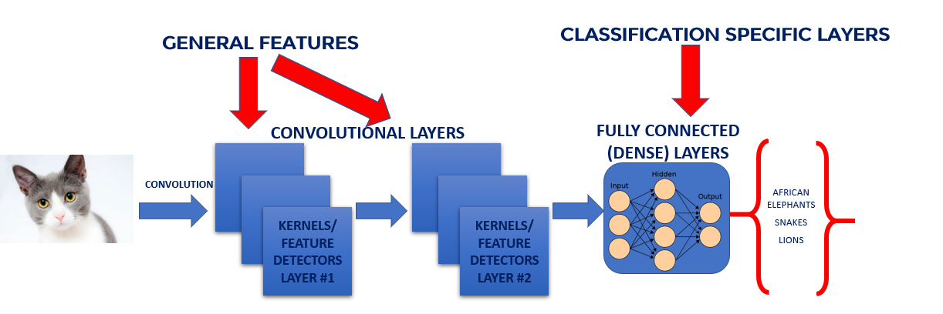

CONVOLUTIONAL NEURAL NETWORKS
The first CNN layers are used to extract high level general features.
The last couple of layers are used to perform classification (on a specific task).
Local respective fields scan the image first searching for simple shapes such as edges/lines
These edges are then picked up by the subsequent layer to form more complex features.

Slide 4
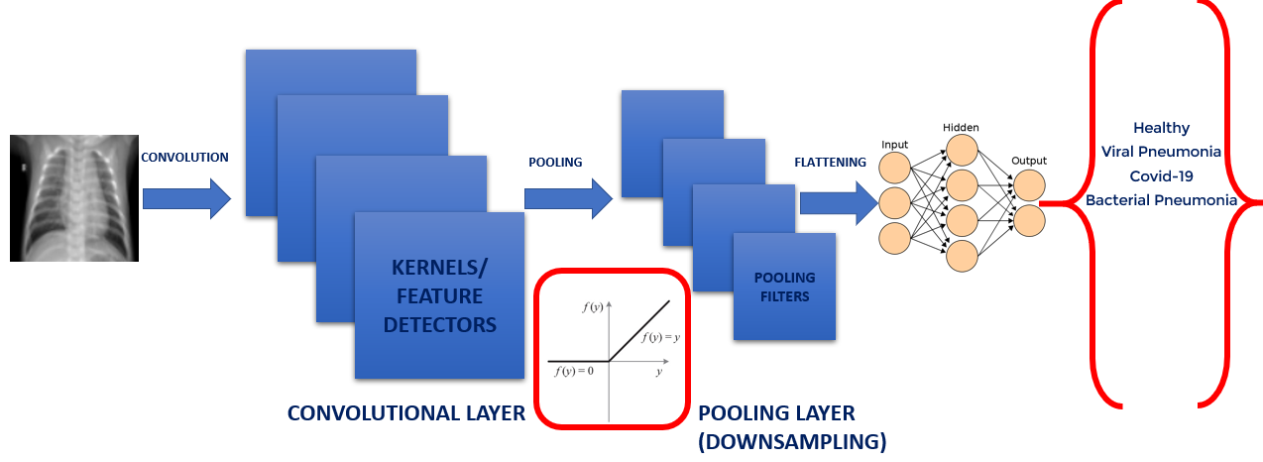
CONVOLUTIONAL NEURAL NETWORKS

Slide 5
DEEP LEARNING HISTORY
There are many trained off the shelve convolutional neural networks that are readily available such as:
LeNet-5 (1998): 7 level convolutional neural network developed by LeCun that works in classifying hand writing numbers.
AlexNet (2012): Offered massive improvement, error reduction from 26% to 15.3%
ZFNEt (2013): achieved error of 14.8%
Googlenet/Inception (2014): error reduction to 6.67% which is at par with human level accuracy.
VGGNet (2014)
ResNet (2015): Residual Neural Network includes “skip connection” feature and therefore enabled training of 152 layers without vanishing gradient issues. Error of 3.57% which is superior than humans.
Source: https://medium.com/analytics-vidhya/cnns-architectures-lenet-alexnet-vgg-googlenet-resnet-and-more-666091488df5

Slide 6
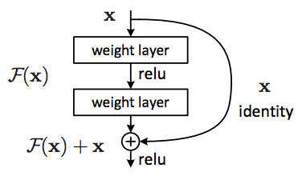
RESNET (RESIDUAL NETWORK)
As CNNs grow deeper, vanishing gradient tend to occur which negatively impact network performance.
Vanishing gradient problem occurs when the gradient is back-propagated to earlier layers which results in a very small gradient.
Residual Neural Network includes “skip connection” feature which enables training of 152 layers without vanishing gradient issues.
Resnet works by adding “identity mappings” on top of the CNN.
ImageNet contains 11 million images and 11,000 categories.
ImageNet is used to train ResNet deep network.

Slide 7
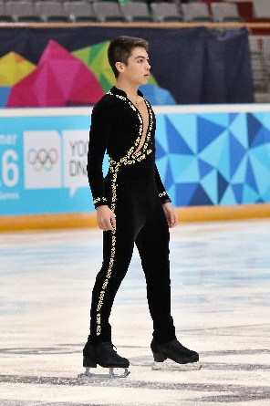
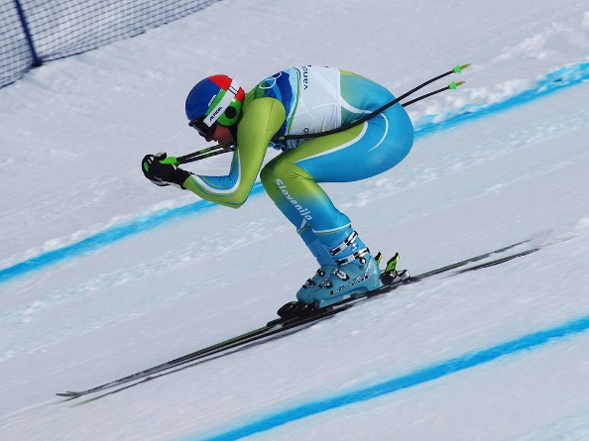
WHAT IS TRANSFER LEARNING?
Transfer learning is a machine learning technique in which a network that has been trained to perform a specific task is being reused (repurposed) as a starting point for another similar task.
Transfer learning is widely used since starting from a pre-trained models can dramatically reduce the computational time required if training is performed from scratch.
KNOWLEDGE TRANSFER
Photo Credit: https://commons.wikimedia.org/wiki/File:Lillehammer_2016_-_Figure_Skating_Men_Short_Program_-_Camden_Pulkinen_2.jpg
Photo Credit: https://commons.wikimedia.org/wiki/Alpine_skiing#/media/File:Andrej_%C5%A0porn_at_the_2010_Winter_Olympic_downhill.jpg
Citations: Olga Russakovsky, Jia Deng, Hao Su, Jonathan Krause, Sanjeev Satheesh, Sean Ma, Zhiheng Huang, Andrej Karpathy, Aditya Khosla, Michael Bernstein, Alexander C. Berg and Li Fei-Fei.
ImageNet Large Scale Visual Recognition Challenge. arXiv:1409.0575, 2014.

Slide 8
WHAT IS TRANSFER LEARNING?
“Transfer learning is the improvement of learning in a new task through the transfer of knowledge from a related task that has already been learned”—Transfer Learning, Handbook of Research on Machine Learning Applications, 2009.
In transfer learning, a base (reference) Artificial Neural Network on a base dataset and function is being trained. Then, this trained network weights are then repurposed in a second ANN to be trained on a new dataset and function.
Transfer learning works great if the features are general, such that trained weights can effectively repurposed.
Intelligence is being transferred from the base network to the newly target network.

Slide 9
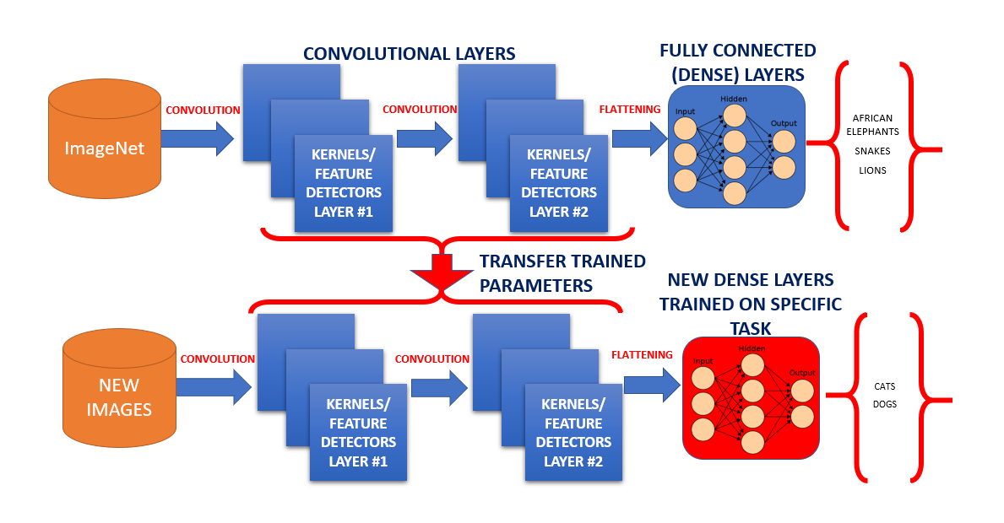
TRANSFER LEARNING PROCESS

Slide 10
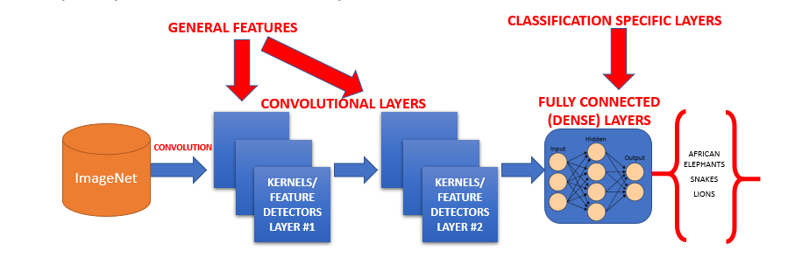
WHY DO WE KEEP THE FIRST LAYERS?
The first CNN layers are used to extract high level general features.
The last couple of layers are used to perform classification (on a specific task).
So we copy the first trained layers (base model) and then we add a new custom layers in the output to perform classification on a specific new task.

Slide 11
TRANSFER LEARNING TRAINING STRATEGIES
Strategy #1 Steps:
Freeze the trained CNN network weights from the first layers.
Only train the newly added dense layers (with randomly initialized weights).
Strategy #2 Steps:
Initialize the CNN network with the pre-trained weights
Retrain the entire CNN network while setting the learning rate to be very small, this is critical to ensure that you do not aggressively change the trained weights.
Transfer learning advantages are:
Provides fast training progress, you don’t have to start from scratch using randomly initialized weights
You can use small training dataset to achieve incredible results

